Slide 1
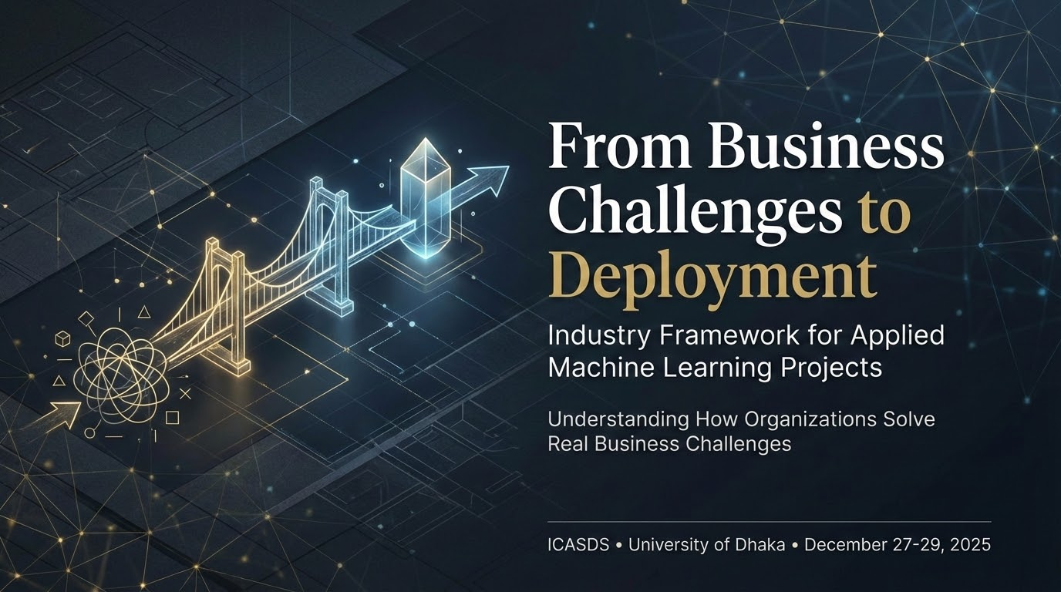

Slide 2
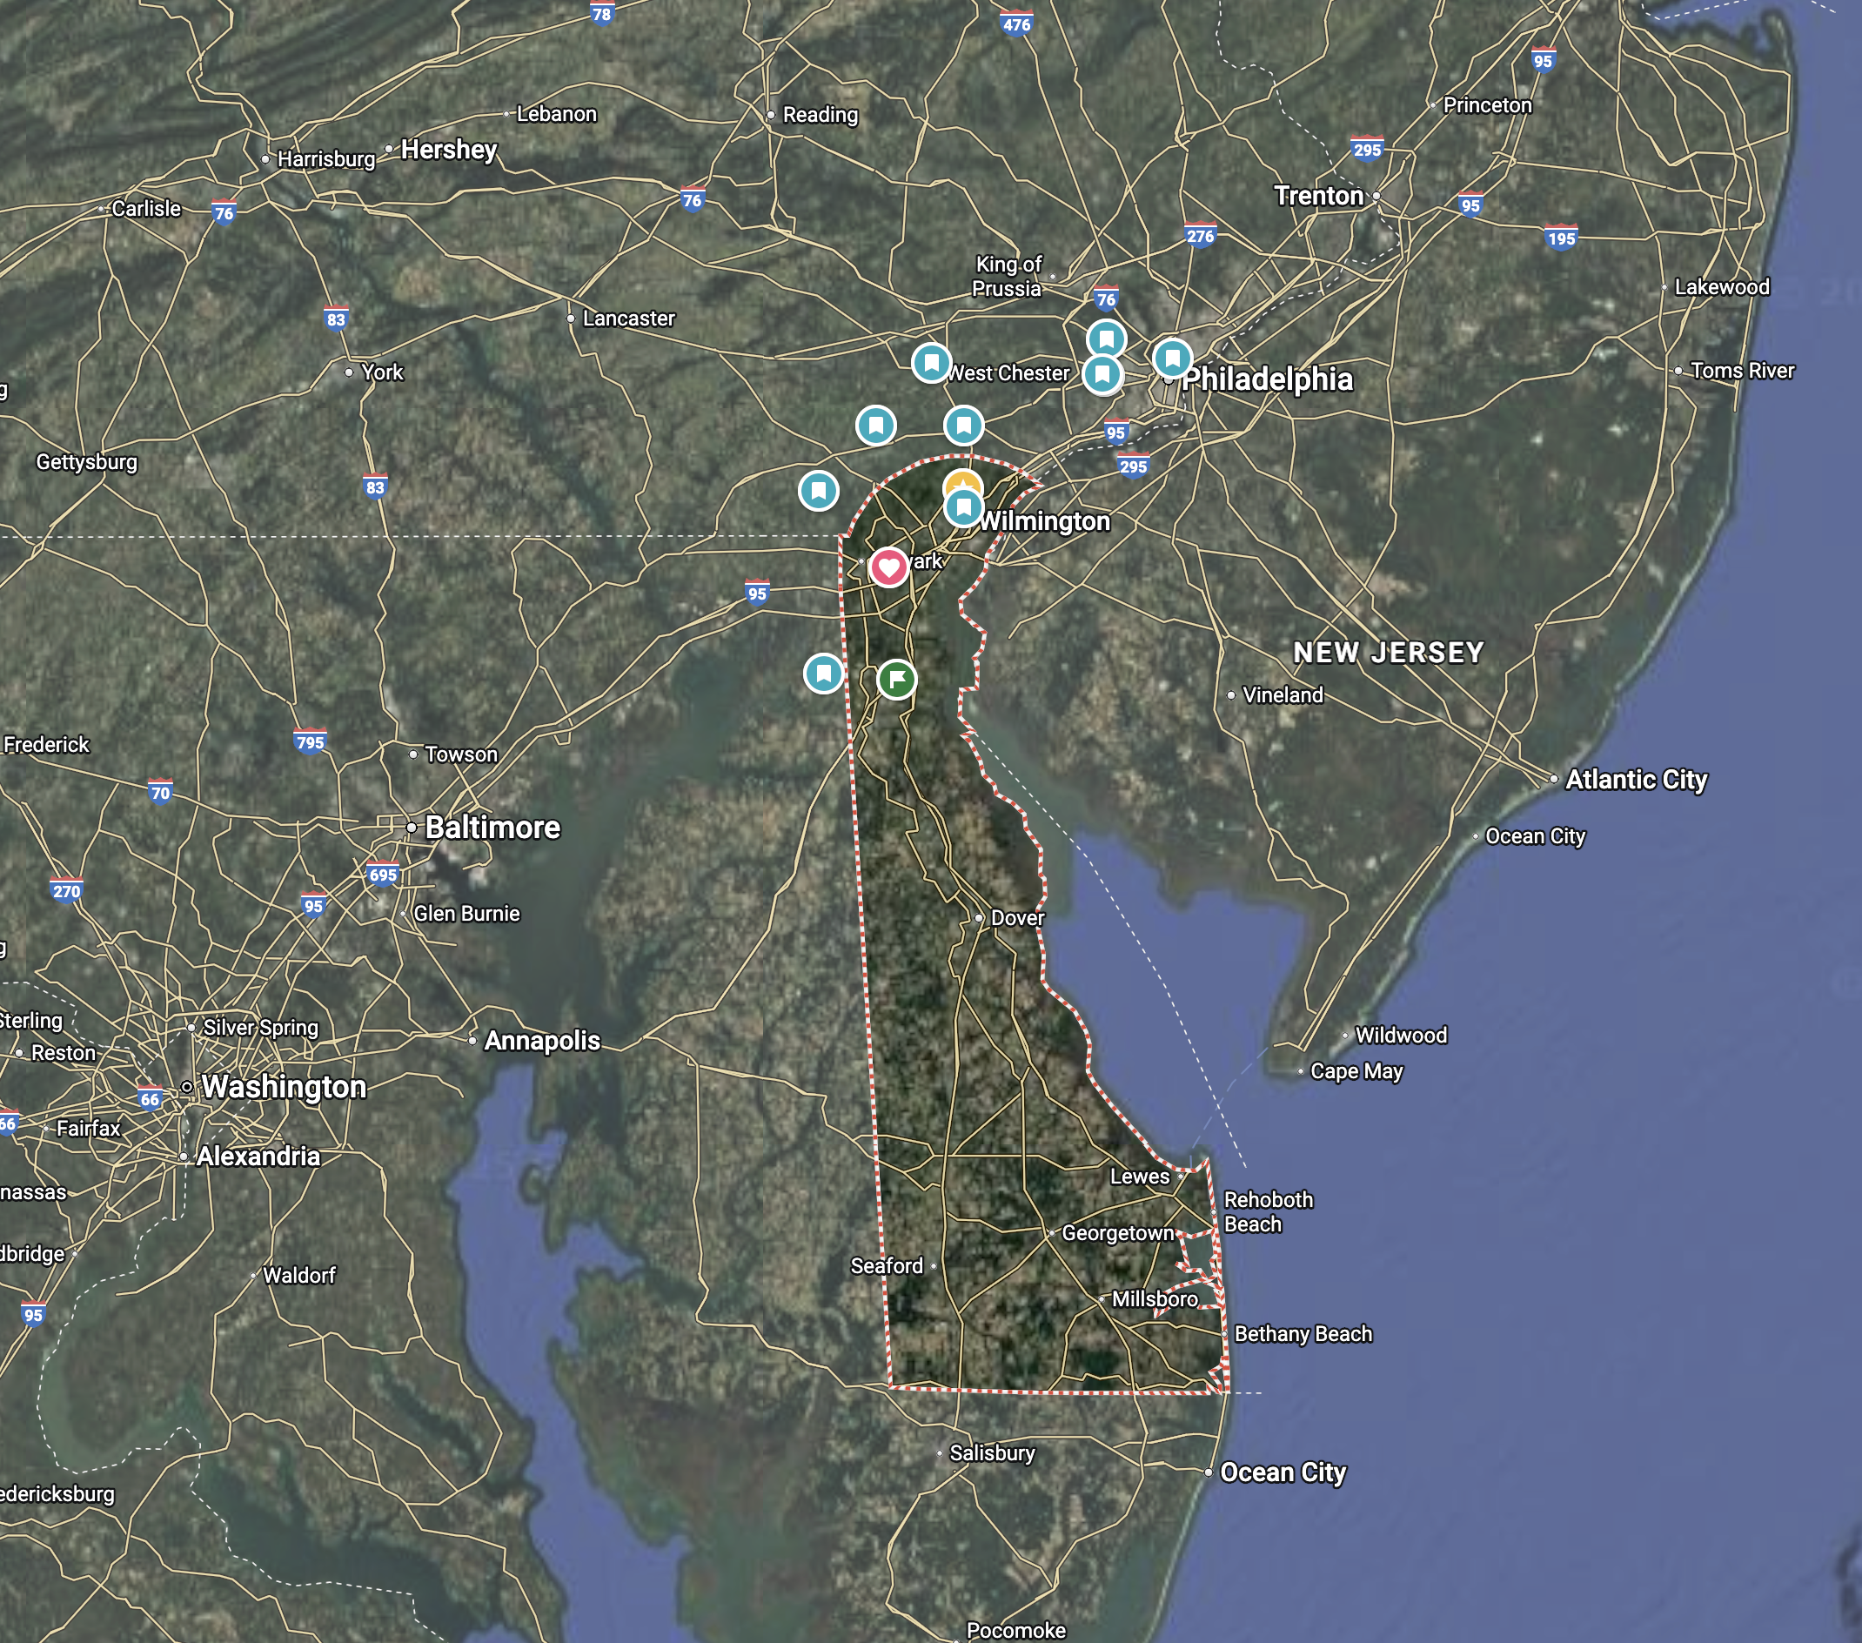
About Me
Enayetur Raheem, PhD
Senior Director, Advanced Analytics
Incyte Corporation Wilmington, DE, USA

Slide 3
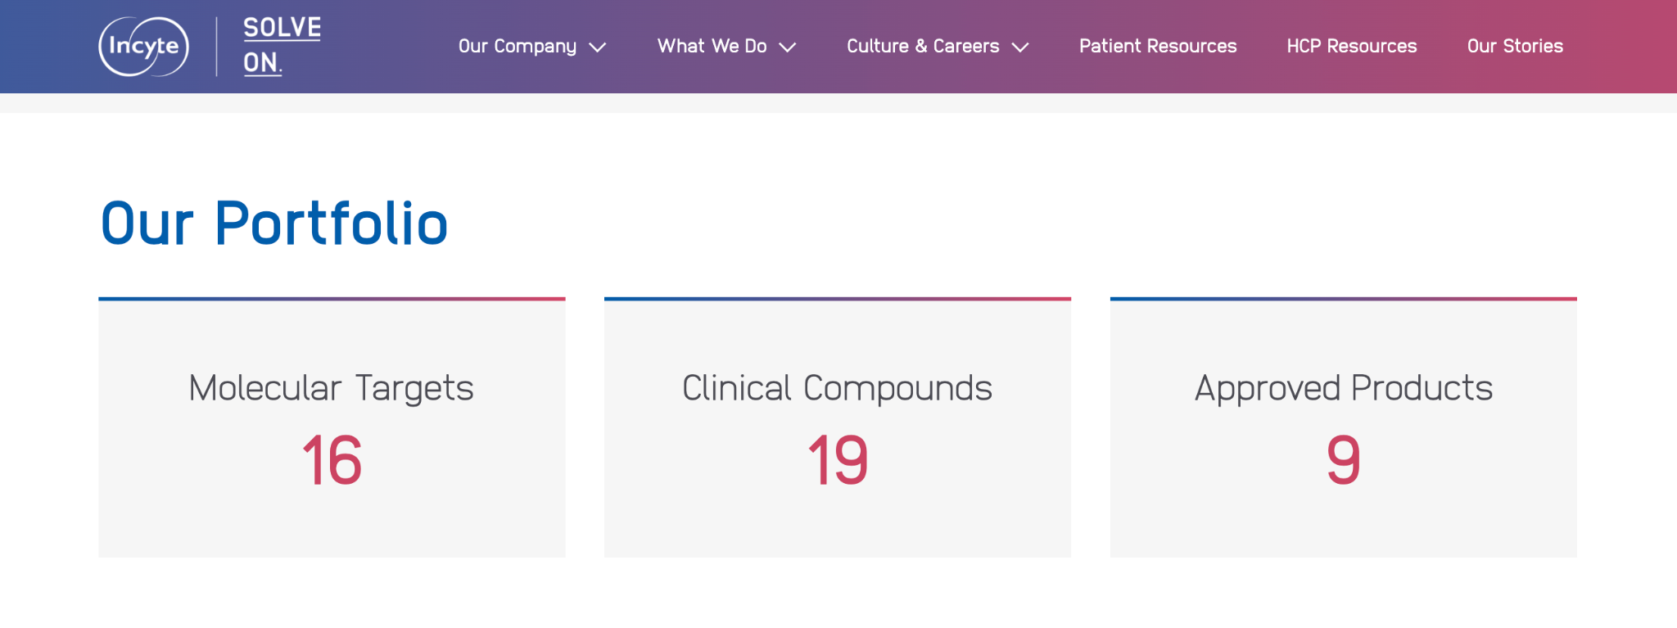
Portfolio
https://incyte.com/what-we-do/pharmaceutical-portfolio
For scientific information only. Not intended as medical advice or as a promotion or solicitation for any medicinal product. Please refer to the locally approved prescribing information and consult a healthcare professional before making any treatment decisions.

Slide 4
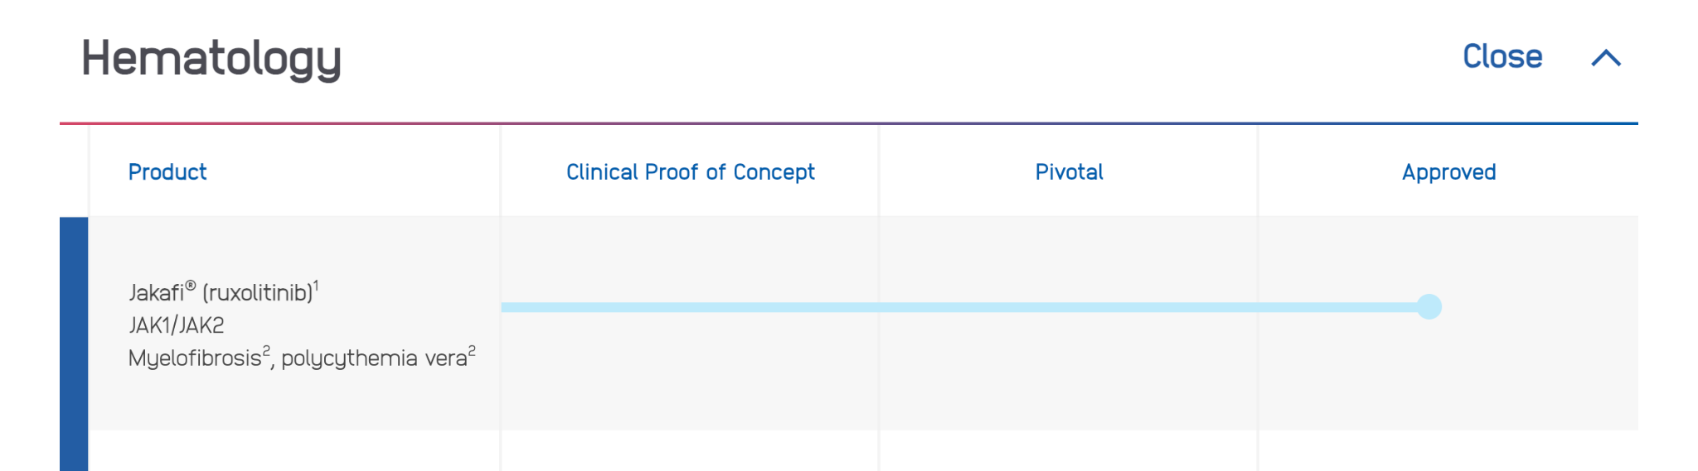
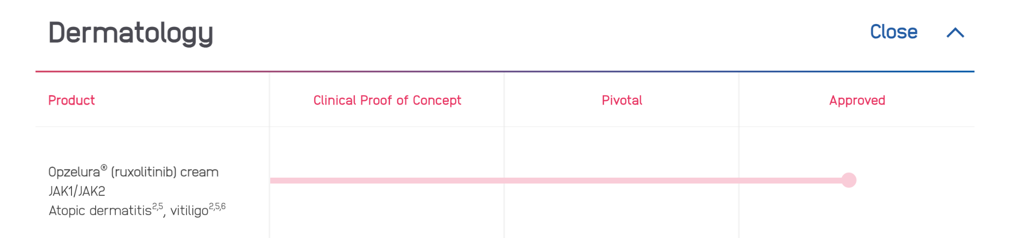
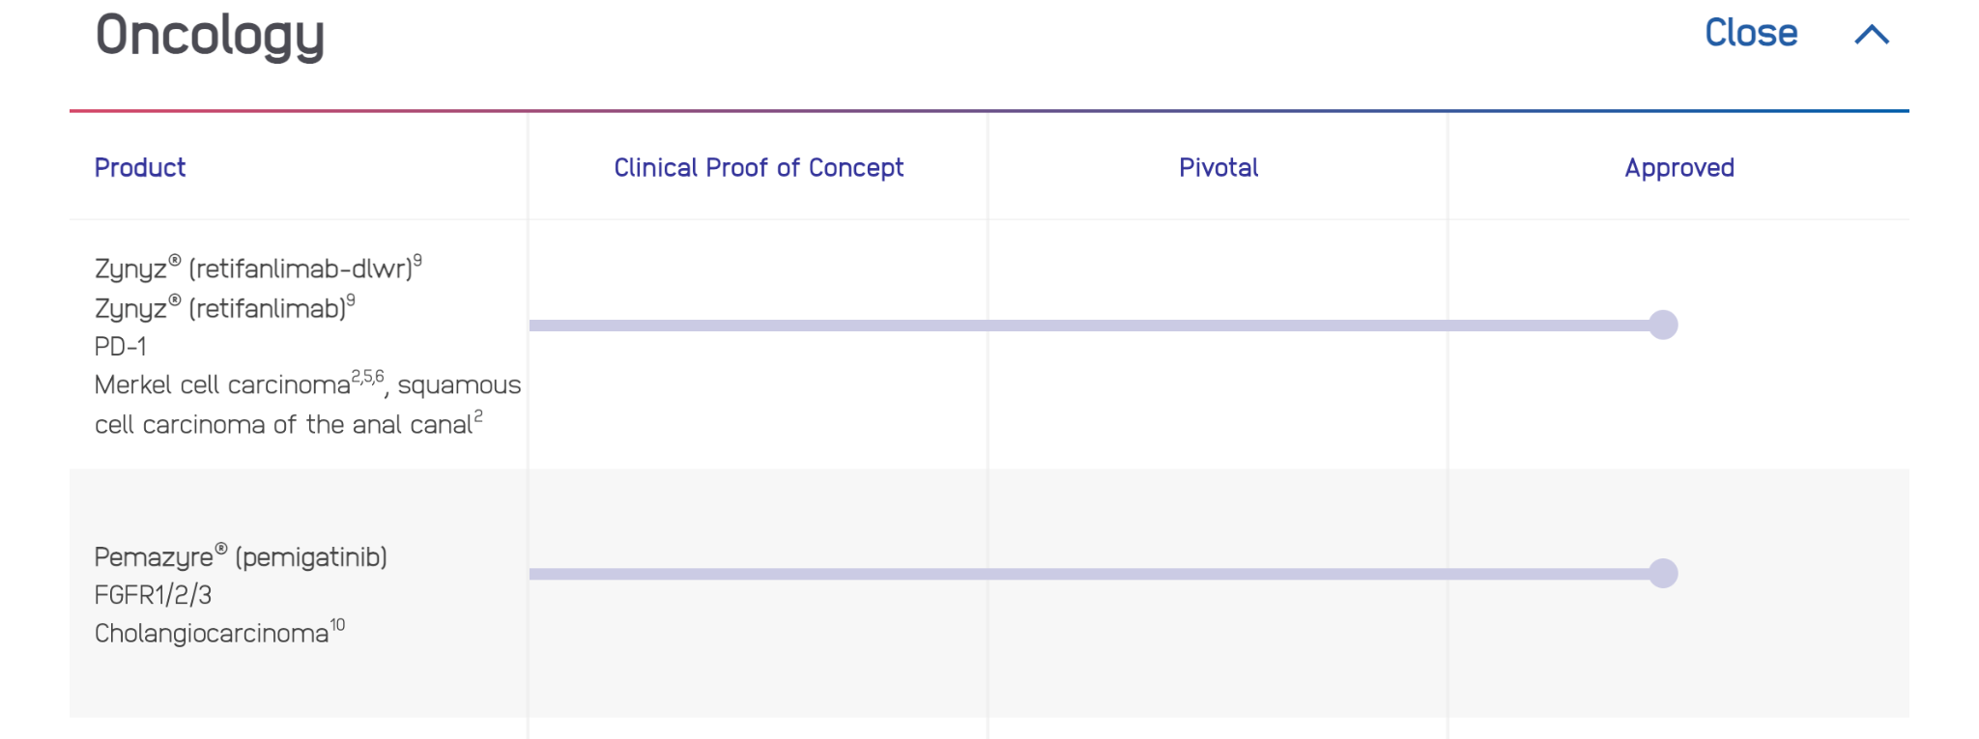
For scientific information only. Not intended as medical advice or as a promotion or solicitation for any medicinal product. Please refer to the locally approved prescribing information and consult a healthcare professional before making any treatment decisions.

Slide 5

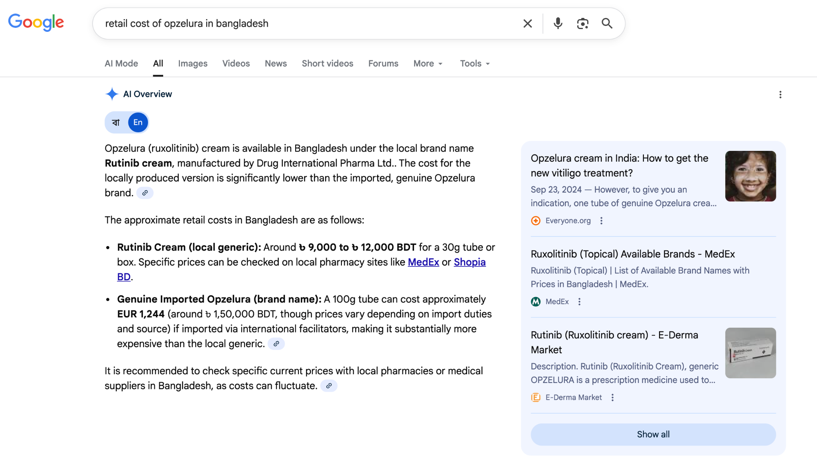
For scientific information only. Not intended as medical advice or as a promotion or solicitation for any medicinal product. Please refer to the locally approved prescribing information and consult a healthcare professional before making any treatment decisions.

Slide 6
Disclosures
I did not receive any funding to offer this workshop
Opinion expressed here are my own and does not represent the company I work for or organizations I am affiliated with

Slide 7
Workshop Structure
1
Industry Perspective
How business leaders identify problems and why data science matters in organizations—the foundation for everything that follows
2
POC Demonstration
Watch a complete end-to-end walkthrough of problem-solving
3
Group Activity
You become the data science team: work in groups to solve different parts of the problem, just like industry professionals do together
4
Group Discussion
Present your team's findings, compare approaches, and learn how different perspectives lead to better solutions—collaborative problem-solving in action

Slide 8
1
Industry Perspective

Slide 9
Why Organizations Invest in Data Science
Financial Impact: Operational inefficiencies cost millions annually
Strategic Need: Competitors are already using predictive analytics
Urgency: Decision-makers need data-driven insights, not gut feelings
Scaling: Manual processes cannot scale to meet demand

Slide 10
The 11-Stage Industry Workflow
A complete data science project typically follows this proven process:
Problem Framing → Stakeholder Alignment → Data Collection → Exploratory Analysis → Feature Engineering → Model Development → Evaluation → Stakeholder Review → Deployment → Monitoring → Iteration

Slide 11
Stage 1: Problem Identification
1
Who Raises the Problem?
Business leaders notice inefficiencies, missed targets, or competitive disadvantages
2
Key Question Asked
"Can we use data to improve this situation?"
3
Initial Assessment
Data science team evaluates feasibility and potential impact

Slide 12
Stage 2: Problem Framing & Metrics
Vague Problem
"We're losing money due to inefficiency"
Well-Defined Problem
"Predict which scenarios will fail so we can allocate resources proactively, targeting 70% accuracy"

Slide 13
Stage 2: Problem Framing & Metrics
Vague Problem | Well Defined Problem
Customer churn is too high | Build a model to predict customers with a <10% probability of renewing their subscription in the next quarter to offer proactive retention incentives, aiming for 85% recall.
Our marketing spend isn't working | Develop a system to optimize ad spend allocation across channels to maximize customer lifetime value (CLV), with a target of a 15% increase in overall campaign ROI within six months.
Our product recommendation engine is bad | Implement a personalized recommendation algorithm that increases the click-through rate (CTR) on suggested products by 5% and drives a 10% uplift in cross-sell revenue within Q3.

Slide 14
Stage 2: Problem Framing & Metrics
Vague Problem | Well Defined Problem
We don't know which patients will enroll | Develop a regression model to predict patient enrollment numbers by trial characteristics (disease type, phase, study design), enabling site managers to adjust recruitment strategies and achieve enrollment targets with 90% accuracy within ±15% of predicted values.
Some trial designs work better than others | Build a feature importance model to quantify which trial attributes (randomization, blinding, patient population size, disease rarity) most strongly predict enrollment success, enabling protocol optimization for future trials with 25% improved enrollment efficiency.
We waste money on struggling sites | Implement a clustering algorithm to segment trial sites by enrollment performance and patient demographics, identifying site types most likely to succeed (>90th percentile) vs. those needing support, enabling smarter site selection for future studies.

Slide 15
Stage 3: Stakeholder Engagement & Alignment
Business Sponsor: Provides funding and executive support
Domain Experts: Share institutional knowledge and constraints
Operations Teams: Understand data availability and limitations
Data Scientists: Assess technical feasibility and propose approach

Slide 16
Stage 4: Data Collection & Preparation
Work with data engineers to access relevant data sources
Validate data quality: missing values, duplicates, inconsistencies
Document data lineage: where it came from, how it was collected
Ensure data governance and compliance requirements are met

Slide 17
Stage 5: Exploratory Data Analysis
Exploratory Data Analysis (EDA) is the most critical step, laying the foundation for the entire project. It involves:
Understanding the Data: Analyzing distributions, relationships, and anomalies.
Validation: Sharing insights with domain experts to validate assumptions and ensure business relevance.
Informing Next Steps: Asking critical questions that guide feature engineering and model selection.
New analysts often skip EDA, rushing to model building (Stage 7). This leads to working with poor quality data and flawed assumptions, resulting in unsatisfactory model performance and requiring a return to the "dirty work" of cleaning and understanding the data. A robust EDA phase significantly reduces wasted time later.

Slide 18
Stage 6: Feature Engineering
Feature engineering is transforming raw data into features
This process is critical for significantly improving model performance
Industry teams create new variables based on domain expertise
It often requires close collaboration with domain experts

Slide 19
Stage 7: Model Development
Key Principle: Start simple, iterate to complexity
Step 1: Build baseline model (logistic regression, decision tree)
Step 2: Compare with advanced models (random forest, XGBoost)
Step 3: Optimize hyperparameters and features

Slide 20
Stage 8: Evaluation Using Business Metrics
NOT Just Accuracy:
Precision & Recall: Balance false positives vs. false negatives based on business cost
ROI Impact: What's the financial benefit of this model?
Operational Feasibility: Can the organization actually use this in practice?

Slide 21
Stage 9: Stakeholder Review & Approval
Present findings in business language, not technical jargon
Show concrete examples and actionable recommendations
Address concerns and constraints raised by stakeholders
Secure sign-off from business leadership before deployment

Slide 22
Stage 10: Production Deployment
Real Impact Happens Here
Work with engineering team to integrate model into business systems
Set up monitoring dashboards to track model performance
Train end-users on how to interpret and act on predictions
Establish feedback loops for continuous improvement

Slide 23
Stage 11: Monitoring & Continuous Improvement
Track model accuracy over time: has performance degraded?
Monitor business impact: are predictions actually helping?
Gather feedback from end-users on real-world usage
Iterate with new data, refined features, or improved models

Slide 24
Typical Industry Team Structure
Data Scientists, Business Analysts
Model development, feature engineering, experimentation
1
Data Engineering
Data pipelines, systems integration
2
Stakeholders, Platform Engineering
Raw data, Business logic, constraints, feasibility review,, infrastructure
3

Slide 25
Ready to Solve Real Problems?
Let's dive into the demonstration and group activities
Remember: Every model in production started with a business problem and a team of people working together

Slide 26
Key Takeaways: Industry Reality vs. Textbooks
60-80% of effort is data prep, not model building
Success requires collaboration across business and technical teams
Business metrics matter more than academic performance scores
Communication skills are as critical as technical skills

